Slide 1
CA: A WATER-SIDE VIEW
Hisham Hussain – Arwa Abdelaziz
DAB-6 Python Project

Slide 2
HYPOTHESES
A greater disadvantaged community increases the time with which the leaks get fixed.
Counties with more disadvantaged communities would have a greater number of leaks.
Most of the amount of the common contaminants are concentrated in a few counties.
Being closer to water bodies affects the number of leaks.

Slide 3
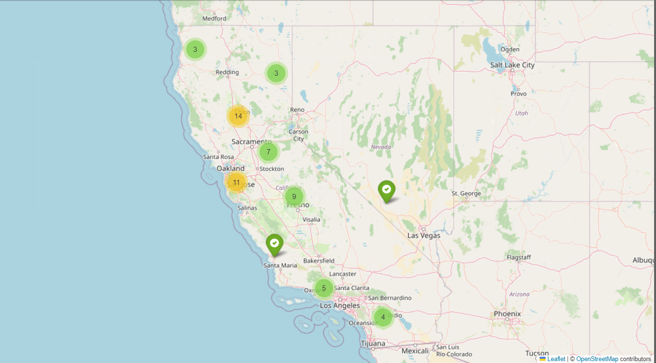
COUNTIES IN CA

Slide 4
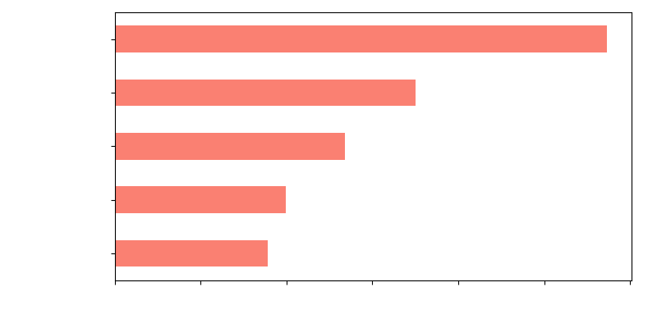
AVERAGE DAYS TO REPORT THE LEAK (TOP 5 COUNTIES)
Days to Report the Leak

Slide 5
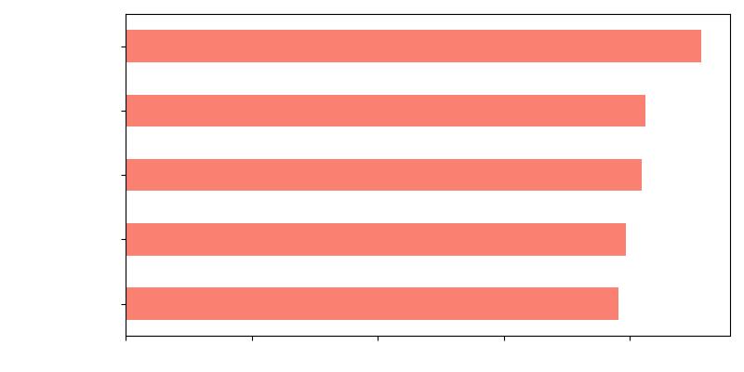
AVERAGE DAYS TO FIX THE LEAK (TOP 5 COUNTIES)
Days to Fix the Leak

Slide 6
Community classification

Slide 7
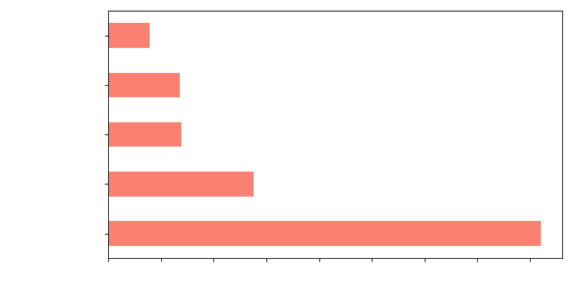
Distribution of disadvantaged communities
Distribution

Slide 8
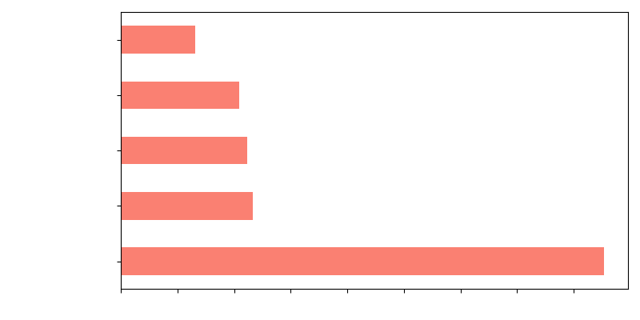
Distribution of severely disadvantaged communities
Distribution

Slide 9
Longest to Report Leakage | Longest to Fix Leakage | Greatest amount of Disadvantaged | Greatest amount of Severely Disadvantaged
San Francisco Yuba Sutter Glenn Stanislaus | Tuolumne Modoc Contra Costa Monterey Sonoma | Los Angeles Kern San Deigo Alameda San Bernardino | Los Angeles Alameda Sacramento San Deigo San Bernardino

Slide 10
CONTAMINANT DISTRIBUTION/CA

Slide 11
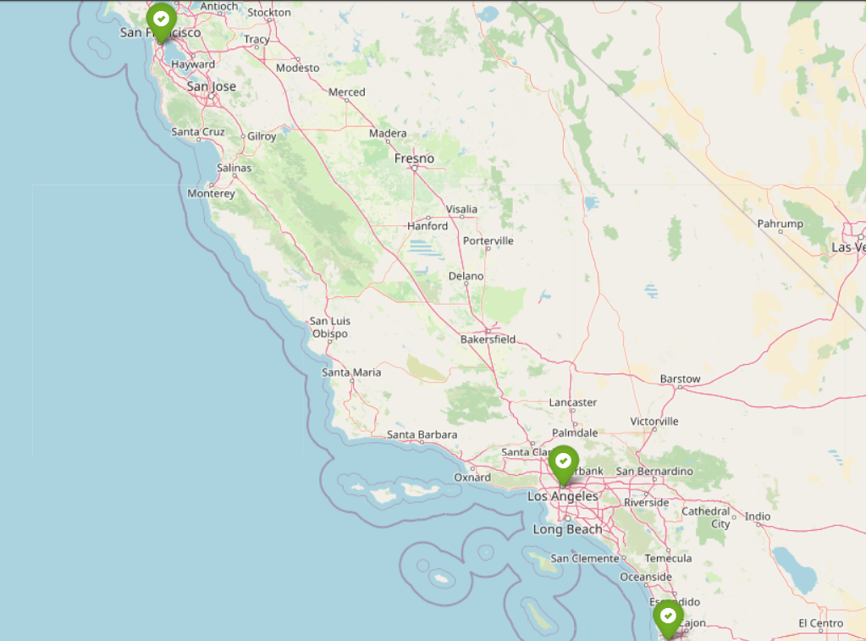
Counties with the top contaminants

Slide 12
CONCLUSION
No correlation between community classification and the length of time of leak reporting and fixing.
The counties with the most disadvantaged have a higher chance to also have a great amount of severely disadvantages communities.
The most common contaminants are concentrated in a few counties.

Slide 13
THANK YOU

